Slide 1


Workout Generator
Victoria Roser

Slide 2

The Social Problem: Personal Fitness
Many people want to stay fit but just don’t know the exercises to do so
There are many exercises that are easy to do at home that require minimal to no equipment

Slide 3

The Solution
Creating a program that allows the user to input workout specifications that would give an output of a randomized list of exercises to meet the user’s specifications.

Slide 4
Program Created: Workout Generator
Type of Workout
Strength Training
Circut training
Upper body
Lower body
Core
Full body
Push
All muscles
Pull
Specific Group
Back
Biceps
Triceps
Chest
Shoulders
Prompts user with questions relating to the workout they would like
Returns a list of exercises

Slide 5
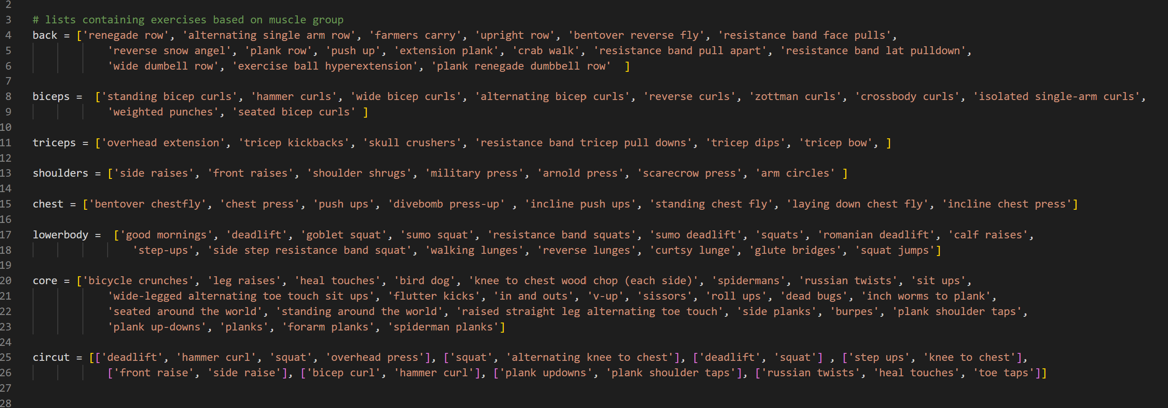
The Exercises

Slide 6
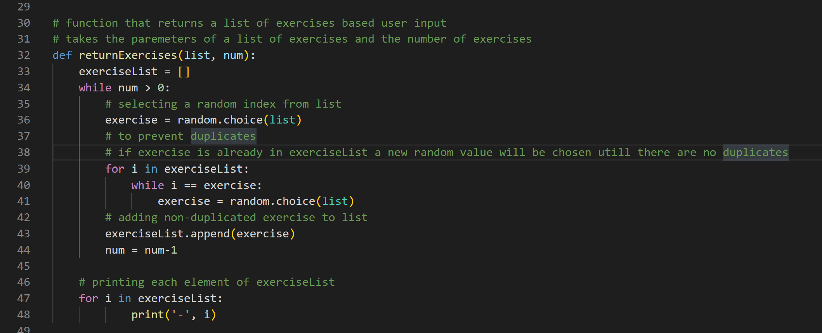
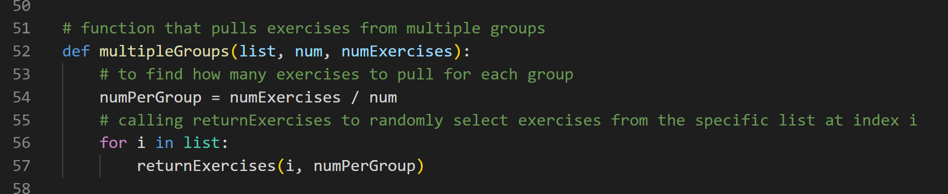
Functions Used

Slide 7
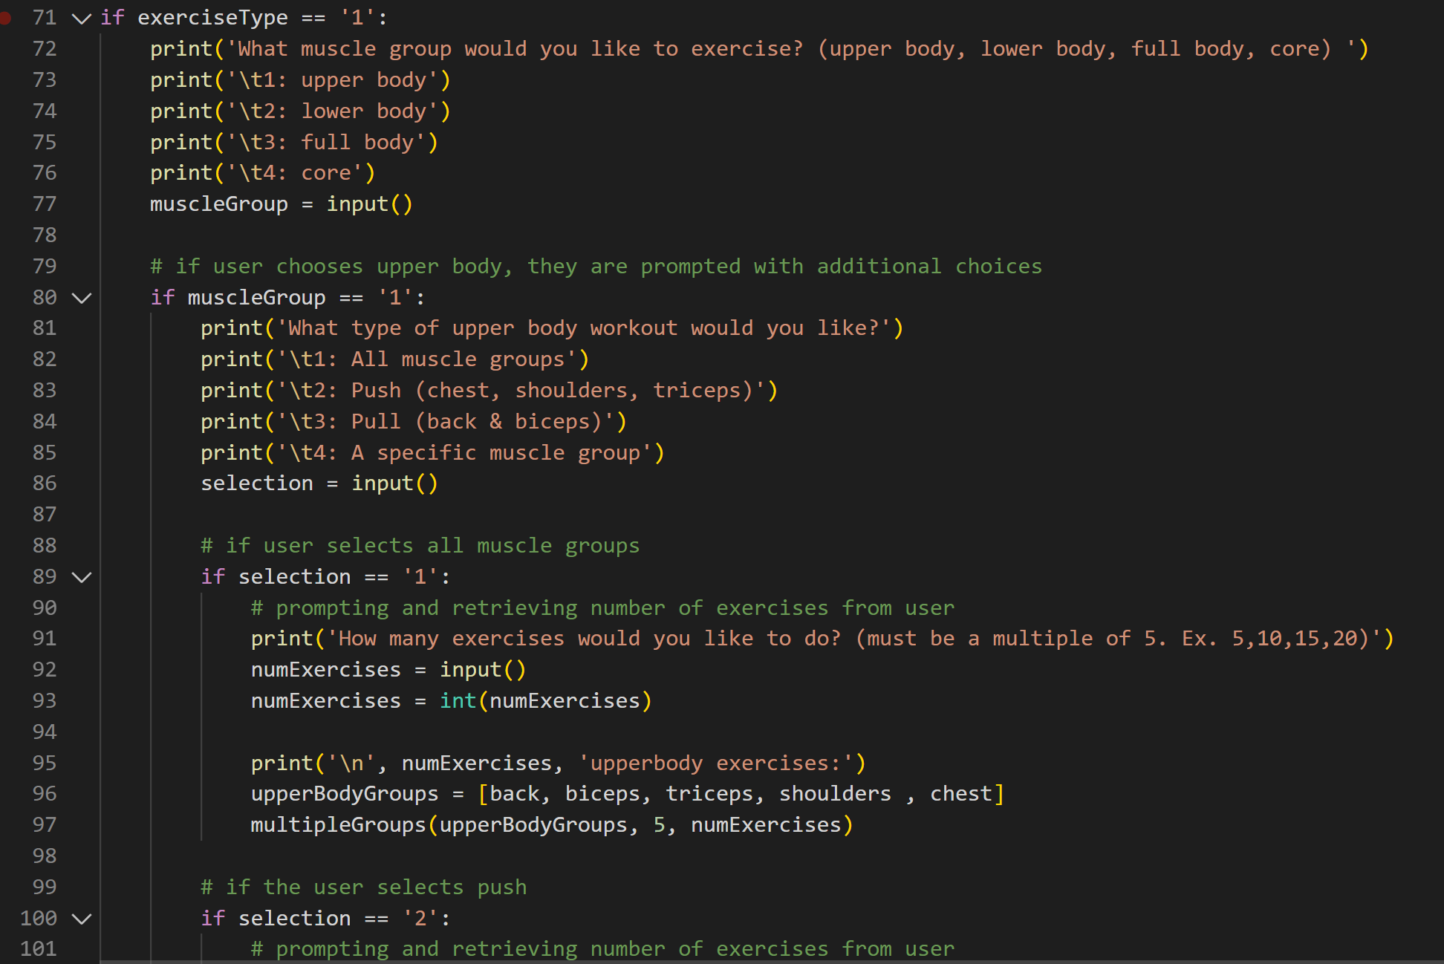
Nested if-statements

